Slide 1
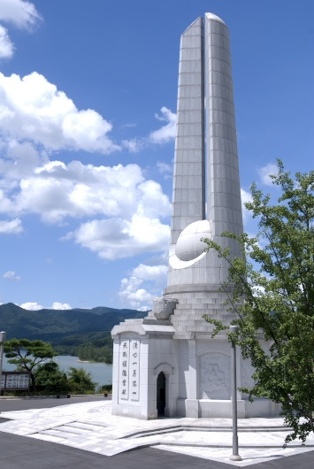
Cheongpyeong World Leaders Workshop OT
Feb. 14, 2014

Slide 2
Contents
1
Schedule
2
Understanding of Cheongpyeong Works
3
Cheongpyeong Heaven and Earth Training Center
4
Chanyang Yeoksa Session
5
Holy Ground Prayer
6
Jeongshim Won Prayer
7
Bath House

Slide 3
1. Schedule
Time | Feb 15(Sat) | Feb 16 (Sun)
05:00 ~ 05:30 | Ancestor Liberation Ceremony: Generations 1-252 Ancestor Blessing Ceremony: Generations 1-245 | Get up and Wash
05:30 ~ 06:00 |  | Hoon Dok Hae
 |  | Breakfast
06:00 ~ 07:30
07:45 ~ 09:00 |  | Chanyang & ALC
09:30 ~ 11:30 |  | Ancestor Blessing Ceremony
12:00 ~ 12:30 |  | Lunch
 |  | Holy Ground & Shower
12:30 ~ 13:30
 |  | Dae Mo Nim’s Words
13:45 ~ 15:00
15:00 ~ 15:30 |  | Commemorative Photo & Jeong Shim Won Prayer
15:30 ~ 17:30 |  | Special Lectures
17:40 ~ 18:20 | Dinner | Dinner
18:50 ~ 20:00 | Opening & Lecture | Lockers for luggage 2nd Basement Level of Main Building - Men: No. 1, 3 Women: No. 4,5,6
20:00 ~ 21:00 | Chanyang Yeoksa Session
21:30 ~ 22:10 | Dae Mo Nim’s Words
22:10 ~ 22:40 | Chanyang Yeoksa Session
22:40 ~ 23:00 | Jeong Shim Won
23:00 ~ 05:00 | Rest

Slide 4
2. Understanding of Cheongpyeong Works
True
Parents
HeungJinNim
84. 1. 2
Seung hwa
DaeMoNim
89. 11. 3
Seung hwa
HoonMoNim

Slide 5
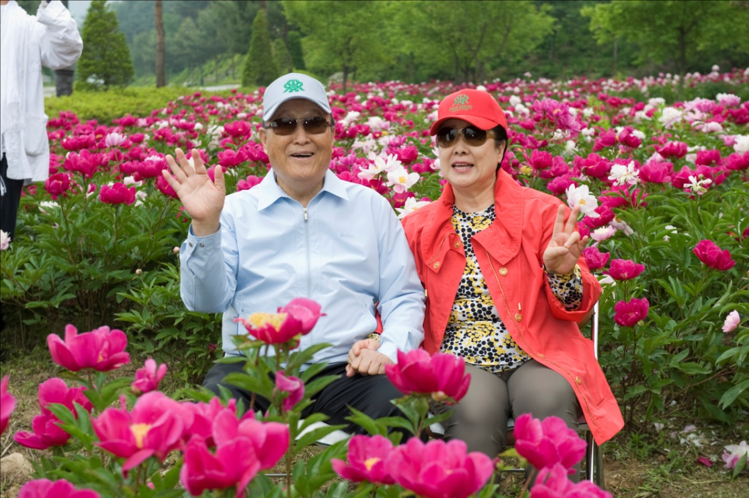
Words on Cheongpyeong Works
“Cheongpyeong Works is to liberate spirits who are attached inside the bodies of human…
There are many evil spirits attached inside our bodies. CP Works is to chase them out of you.”
(Vol. 301, Page 209: May 1, 1999)

Slide 6
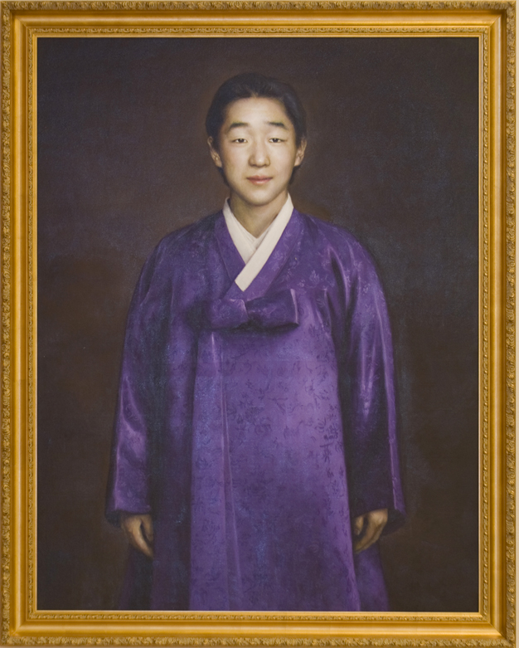
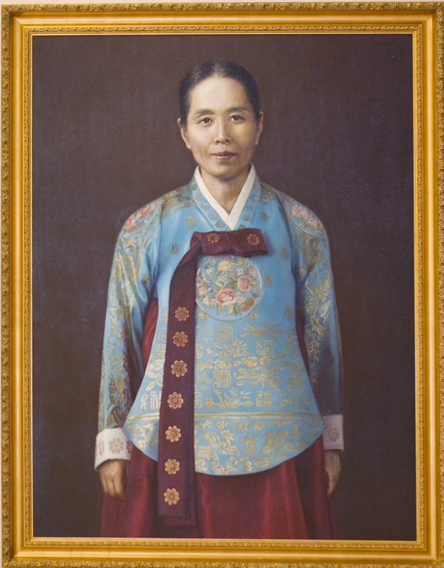
Heung Jin Nim Dae Mo Nim

Slide 7
Panoramic View

Slide 8
3. Cheongpyeong Heaven & Earth Training Center
Chin hwa Hall
Jeong Shim Won
Bath house
store
Cheongshim Tower
Heavenly Palace
Calligraphy Stone

Slide 9
3. Cheongpyeong Heaven & Earth Training Center
Main Gate
Along the street, Bus stop

Slide 10
1st floor Korean/International Office, Japanese Office Small Hall (A, B), Consulting Office, VIP rooms (1~7),
D Wing faces
Cheongpyeong Lake
107
106
105
104
103
102
101
Women’s Restroom
consulting room
Women’s Restroom
A
B
B Wing faces
Cheongshim Tower
Small Hall
Men’s Restroom
International Office
Korean /
International Office
Education & Planning
Japanese Office
Men’s Restroom
C Wing faces the Tree of Love

Slide 11
Basement 2nd floor Ancestor Liberation Registration Booth, Seil Travel
Office hours 10:00am - 22:00pm

Slide 12
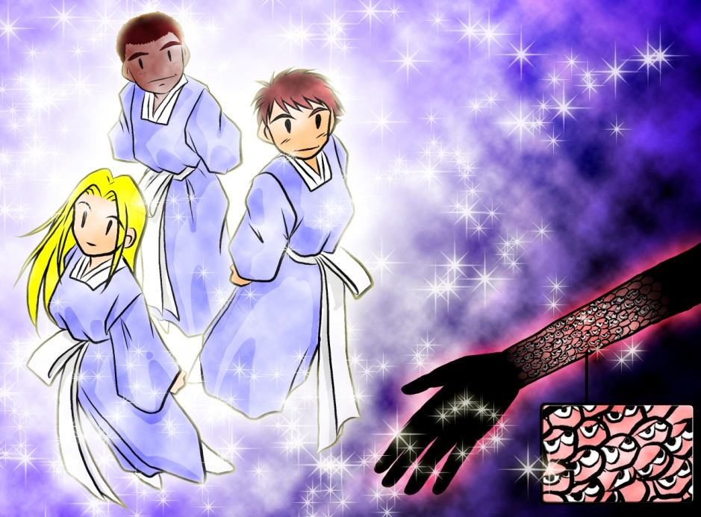
4. Chanyang Yeoksa Session
- Piled up like ant eggs
- They are rooted all over the body in order
- Centering on the most resentful spirit

Slide 13
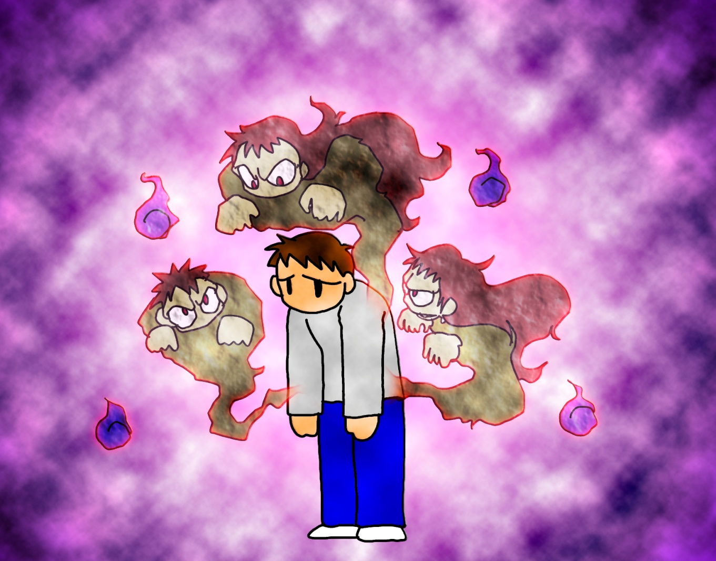

Slide 14
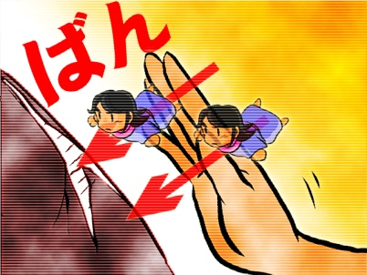
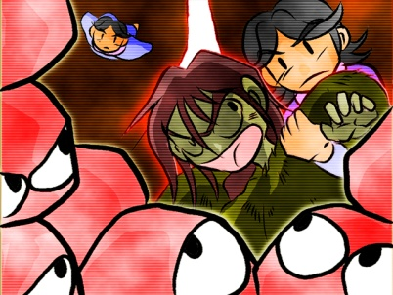

Slide 15
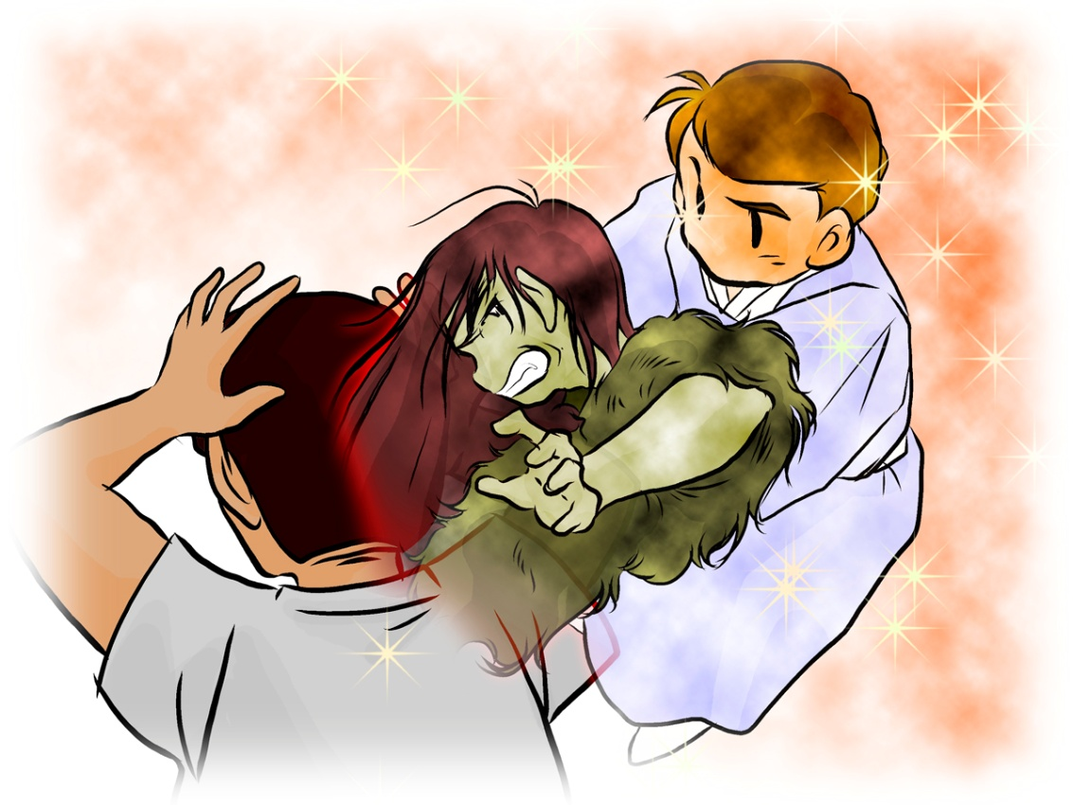

Slide 16
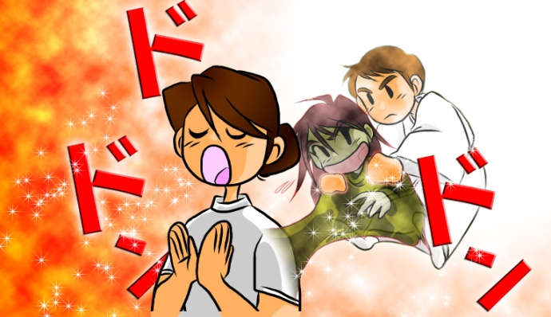

Slide 17
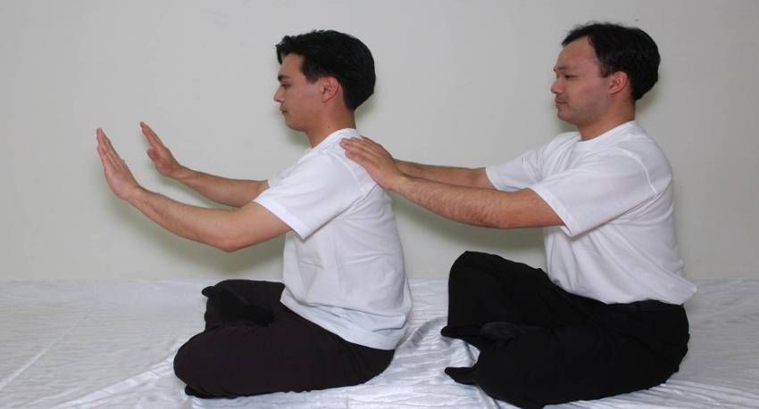
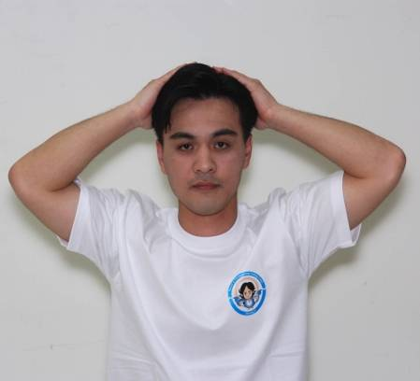
4. Chanyang Yeoksa Session

Slide 18
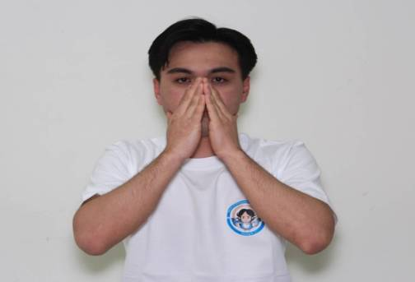
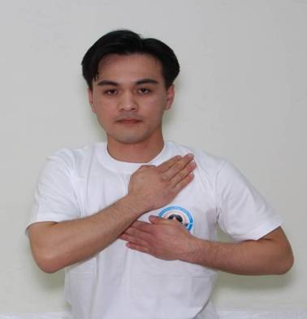
4. Chanyang Yeoksa Session

Slide 19
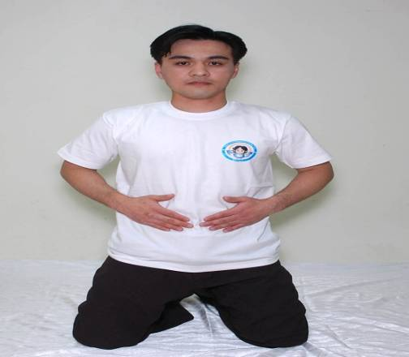
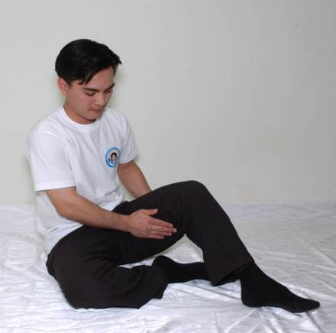
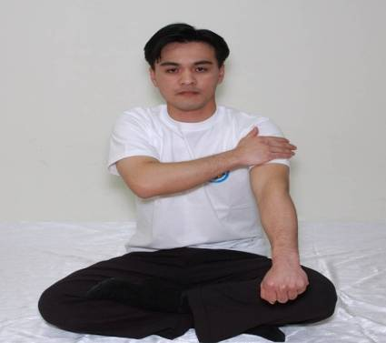
4. Chanyang Yeoksa Session

Slide 20
5. Holy Ground Prayer
To bring back love, Shimjeong (heart), all things, loyalty, blessing and new life lost by the human fall, through sincere prayer, thereby engraft into the lineage of God.
When you offer a prayer at the holy ground, angels assist you to live a blessed life by separating evil spirits living inside your bodies & disturbing your true life.

Slide 21
5. Holy Ground Prayer
Therefore, we pray, after grasping visible trees and water.
It is inheriting and engrafting love, Shimjeong (heart), all things, loyalty, blessing and new life which you want to recover.
Why do
we need
to go?
We must bring back love, Shimjeong (heart), all things, loyalty, blessing and life lost by the human fall, but it is ambiguous to get back from nothing.

Slide 22
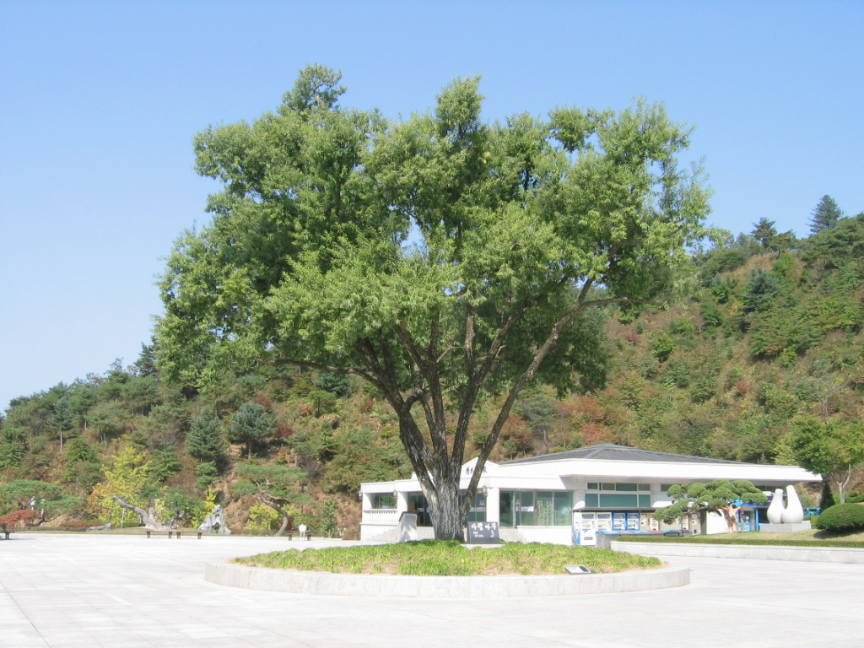
Tree of Love - sallow tree
The Place where the angels that came to separate evil spirits stay.

Slide 23
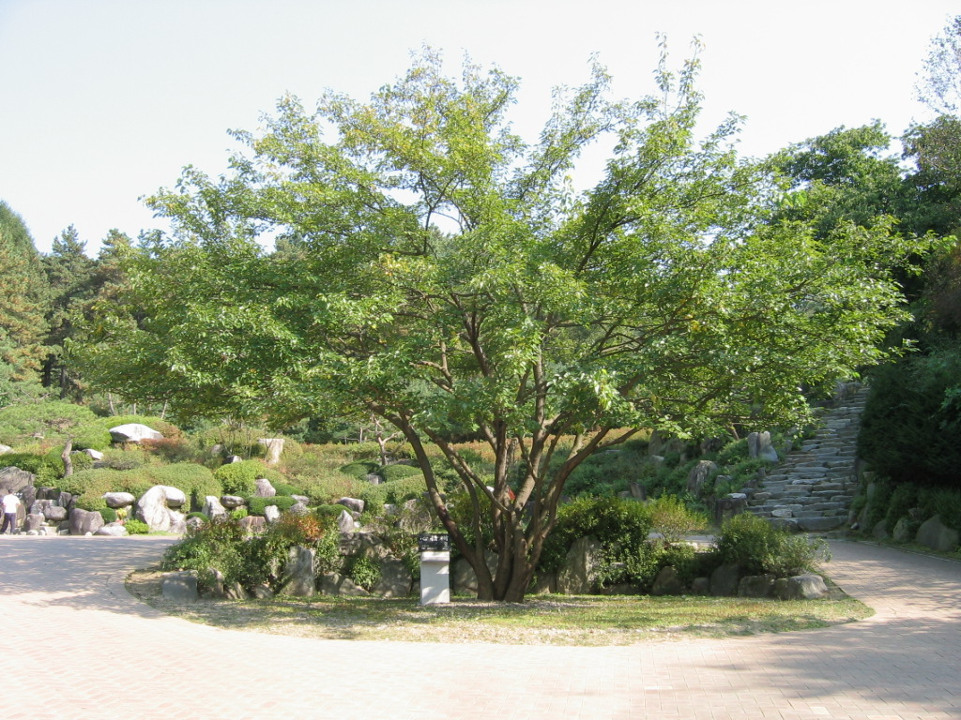
Tree of Shimjeong (Heart) –mulberry tree
Place where we can forgive sinners in God’s shimjeong and repent my sins of violation of the heart

Slide 24
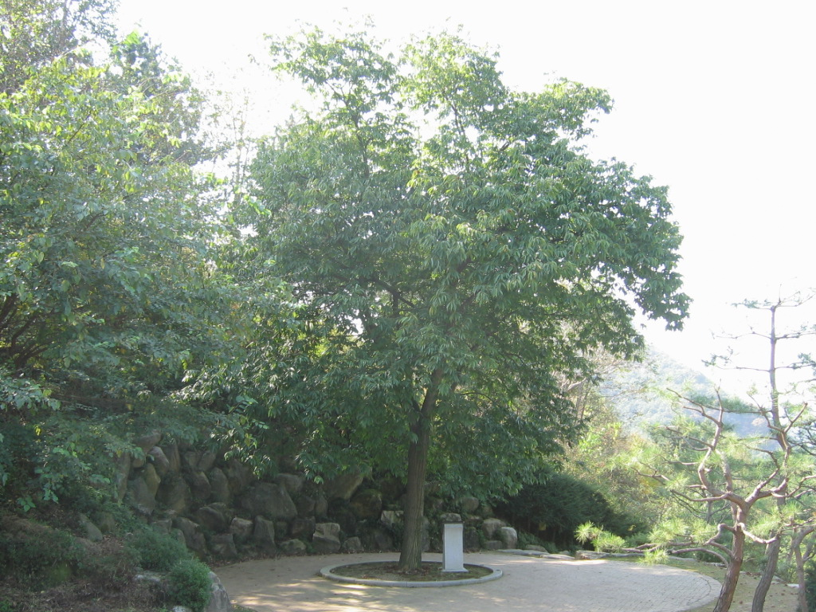
Tree of All Things – chestnut tree
Place where abundant blessing of all things can be received through heaven’s grace.

Slide 25
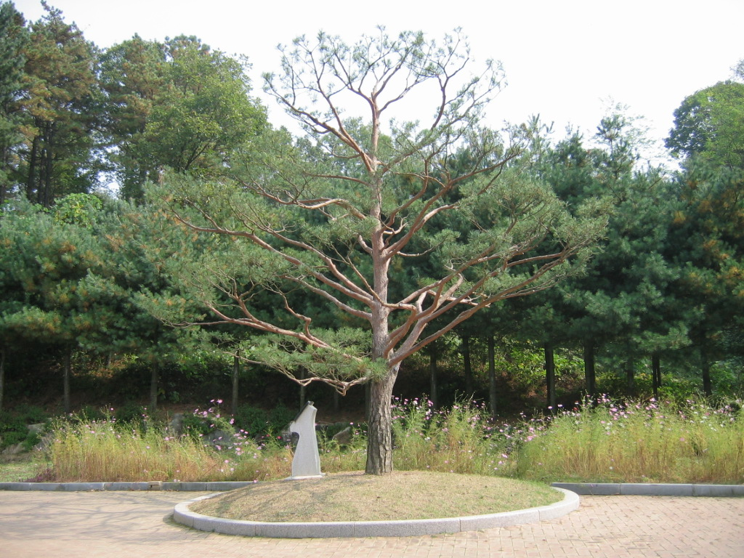
Tree of Loyalty – pine tree
Place where we determine to dedicate and be devoted to God

Slide 26
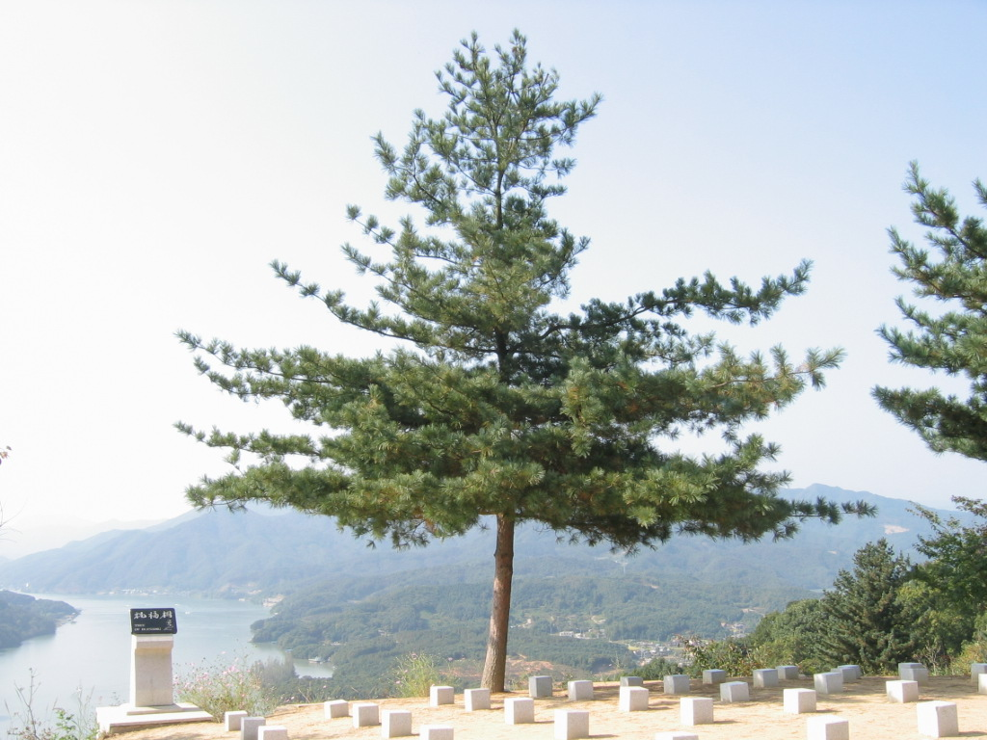
Tree of Blessing –White pine tree
The way for God to give all blessed families His blessing

Slide 27
Integrated to Prayer at the Tree of Blessing
Prayer at
the Tree of
Blessing
(2001. 6. 4)
Prayer at
the Tree
of Love
Prayer at
the Tree of
Loyalty
Prayer at
the Tree of
Shimjeong
Prayer at
the Tree of
All Things
Leaving a minimum number of angels in each of the trees, most angels now do works at the Tree of Blessing

Slide 28
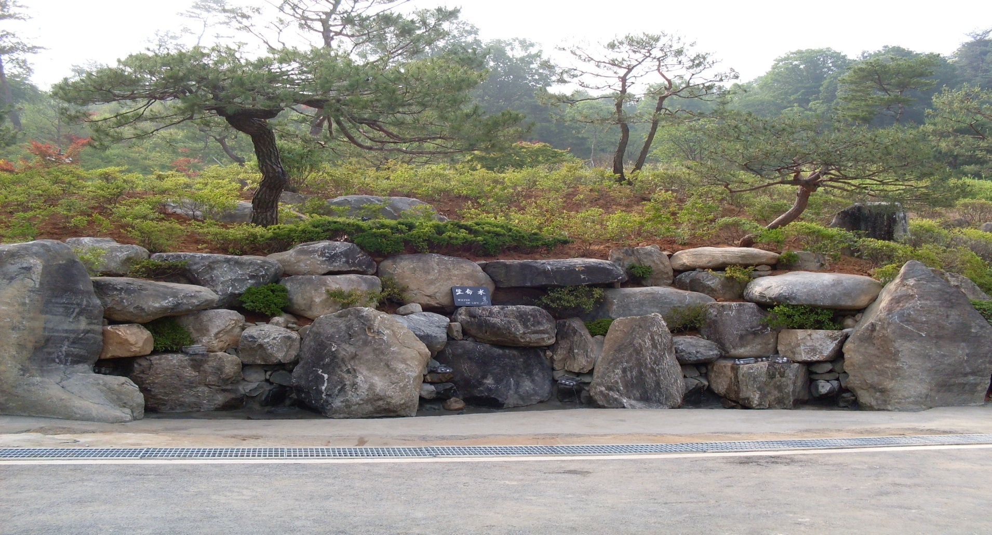
Water of Life
There is the grace of restoring false lineage to true lineage, and incredible works of curing diseases by the angels that add the SP-right medicine.

Slide 29
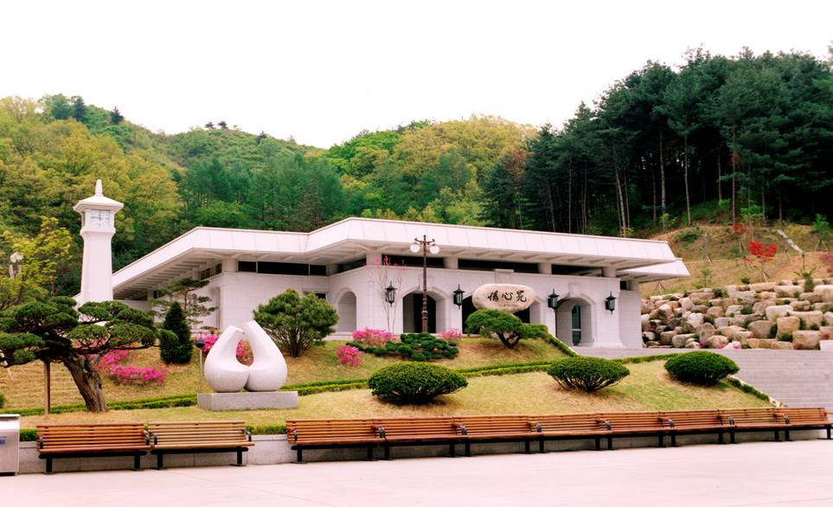
6. Jeongshim Won
History
2014
6. 2
2001. 1. 13
2000. 4. 4
3. 26
1995. 1. 19
Integration to Jeongshim Won Prayer
Coronation of God’s Kingship
Offering Ceremony of Jeongshim Won
Beginning of Tree of Love Prayer (from 100th 2 day workshop)
Beginning of Cheongpyeong Works
1995

Slide 30
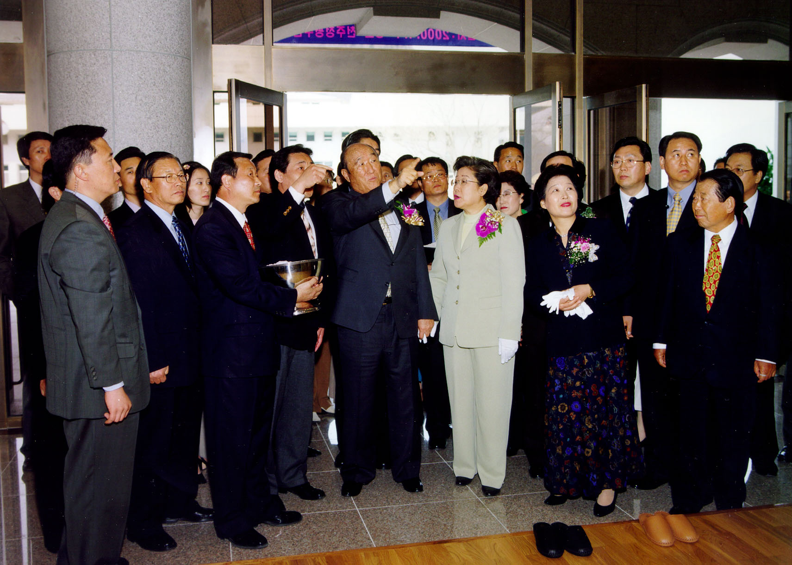
6. Jeongshim Won

Slide 31
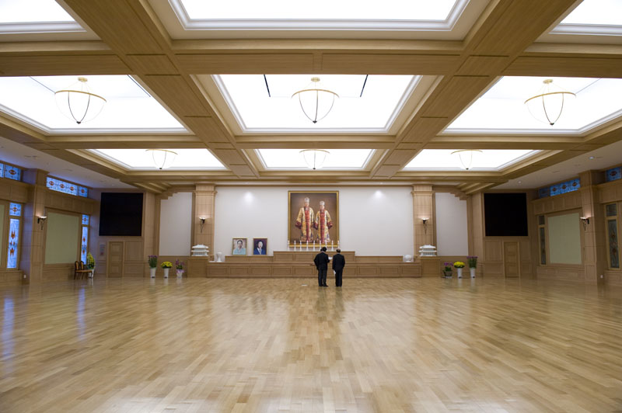
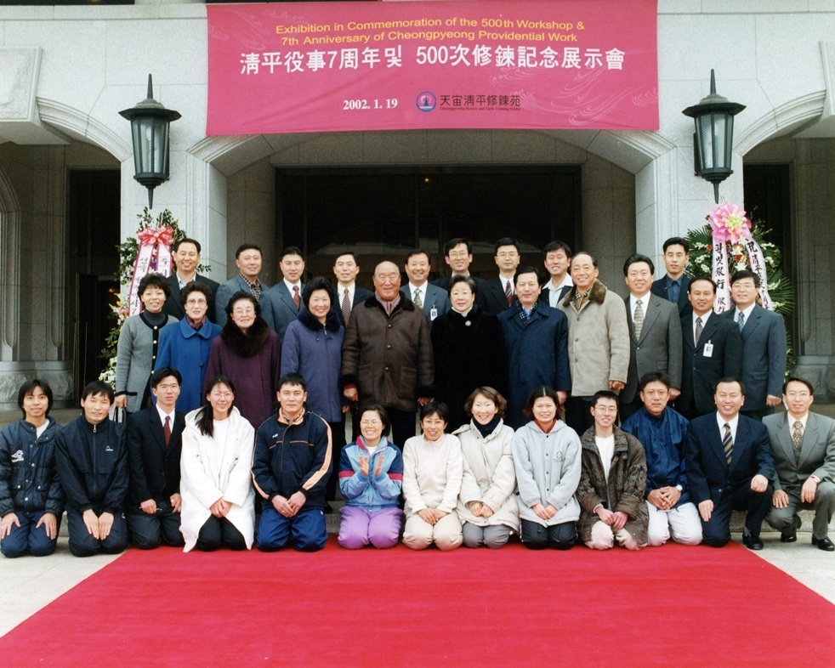
6. Jeongshim Won
Do not talk to others
Wear socks at all times
Before turning your back to leave,
take 3 steps backwards and bow.

Slide 32
6. Jeongshim Won
Placement of special angels
Grace of Jeongshim Won
Prayer
Our prayers are delivered as letters
The angels report directly to God
The grace of the wishes coming true greatly
1. Always wear a white top: reason -
Attention!
2. Praying time : After every CY session 10 PM closing prayer
3. Please never touch the candles

Slide 33
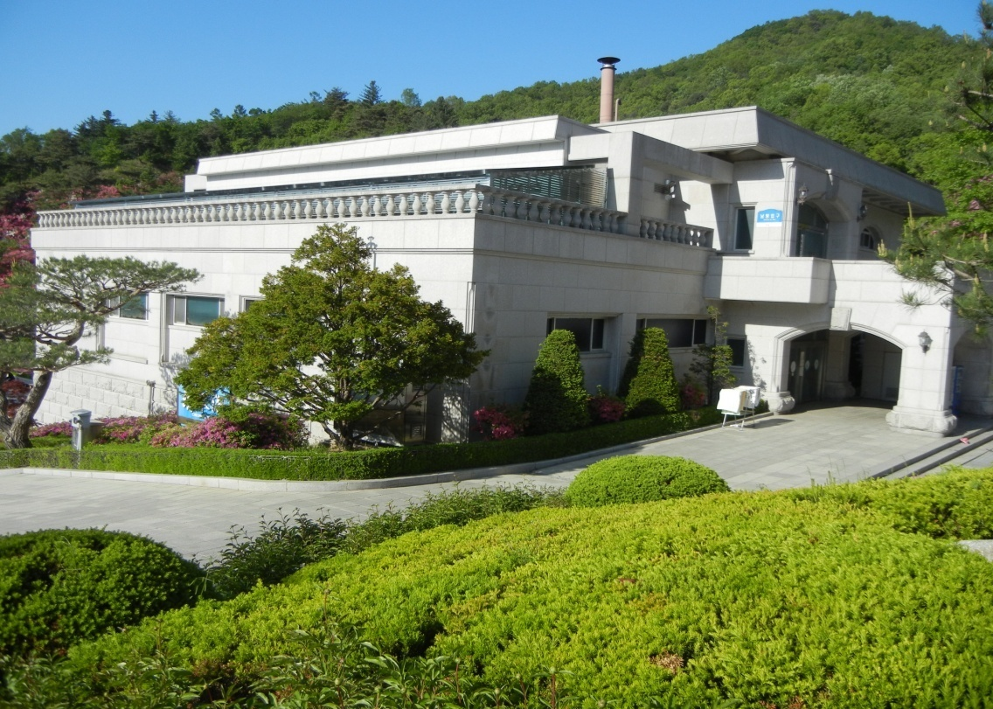
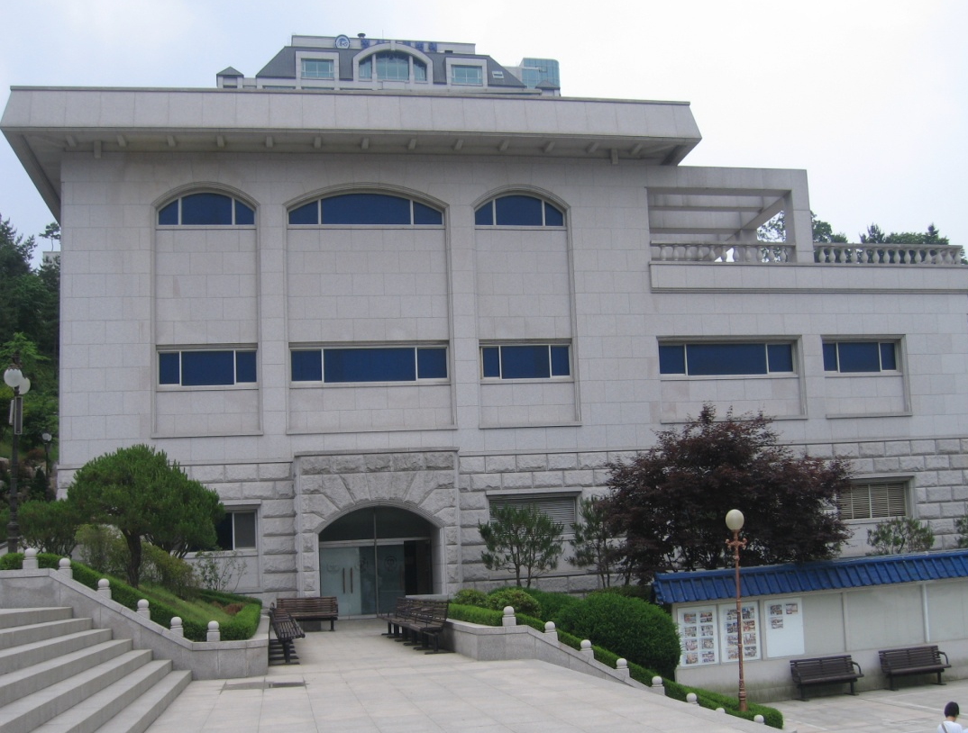
7. Bath House
Brother’s entrance
Entrance to sisters showers
and laundry room

Slide 34
Thank You !
I hope you can receive
much grace during this
2 day workshop!

