Slide 1
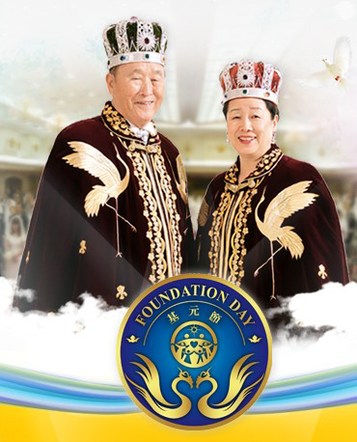
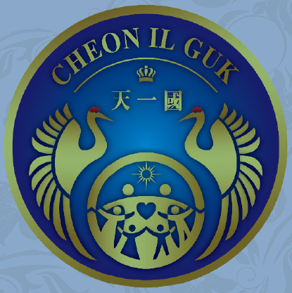

Vision
2020
Value of
True Parents
&
Why CP Works?
Jan.16, 2nd Year of CIG
(2014. 2. 15)
President Jin Choon Kim, Ph.D.
Cheongshim Graduate School of Theology

Slide 2



1st
Coming
2nd
Coming
3rd Age
(Rule of LSA)
4th Age
(Completed CIG)
Creation
1st Age
2nd Age
Now
3rd Blessing
Kingdom of God
centered on True Parents
2nd Blessing
1st Blessing
CIG Age
God
Kingdom of God
centered on True Parents
2001
2012
Father’s
Seonghwa
Creation
True
Parents
1945
Kingdom of God
centered on True Parents
Goal of Human History :
“Kingdom of God
centered on True Parents ”
● Life of True Parents :
“Kingdom of God
centered on True Parents”
“It is Finished” (Conclusion over all)
Jesus
Fall
Restoration
Adam
Eve
F. Adam/Eve

Slide 3

True Parents are the Master Key
“The wish of humankind is meeting TP.
The fruit of history is meeting TP.
The center of this era is meeting TP.
The beginning point of the future is meeting TP.
You who are engrafted on to TP will be a branch,…
Your connection with TP is only once in eternity.
It is a very special event, only one time in your life.
Your ancestors didn’t have this chance and
your descendants will not have this, either. (Cheon Seong Gyeong, pp.233-234; 71.8.13)

Slide 4
Why True Parents?
From the view of
God
From the view of
True
Human Being
From the view of
Rebirth & Messiah
Why
True Parents
?
From the view of
True Love
From the view of
Fall & Restoration
From the view of
3GBs
From the view of
God’s Word

Slide 5
Why True Parents? : in view of God
God is a harmony of Yin & Yang
⇒ To resemble God
we should be a harmony of
Male & Female
(Not single)
God is the origin of True Parent, True Teacher, True Owner
⇒ To resemble God
we should become True Parent first
(Not single)
God is the origin of True Love, True Life, True Lineage
⇒ To resemble God
we should be True Parent to give true life and have true lineage
(Not single)
From the view of
God
Why
True Parents
?

Slide 6
Why True Parents? : in view of True Human Being
From the view of
God
From the view of
True
Human Being
Why
True Parents
?
God-Human is Parent-Child relationship
⇒ To become God’s Object
We should resemble Parent
(Not single)

Slide 7
Why True Parents? : in view of True Love
From the view of
God
From the view of
True
Human Being
God is the origin of Children’s Love, Sibling Love, Conjugal Love, and Parental Love
⇒ To inherit 4 types of
True Love
We should become
True Parent
(only True Parent can have 4 types of True Love)
(Not single)
Why
True Parents
?
From the view of
True Love

Slide 8
Why True Parents? : in view of 3GBs
From the view of
God
From the view of
True
Human Being
Three Great Blessings are possible by True Parent
⇒ To accomplish the purpose of creation (3GBs)
We should become True Parent
(2nd Blessing, 3rd Blessing can be possible by Parent)
(Not single)
Why
True Parents
?
From the view of
True Love
From the view of
3GBs

Slide 9
Why True Parents? : in view of 3GBs
From the view of
God
From the view of
True
Human Being
Why
True Parents
?
Ideal of creation(CIG) can be realized by True Parents
⇒ True Parents are so essential,
fundamental, crucial, and basic requirement
From the view of
True Love
From the view of
3GBs
From the view of
CIG

Slide 10
Why True Parents? : in view of Fall & Restoration
The most crucial result of the Fall is that there is no True Parent
⇒ To restore we need True Parent
(Single cannot restore)
The goal of human history is to have True Parents
⇒ True Parents are the conclusion of the entire human history
From the view of
God
From the view of
True
Human Being
Why
True Parents
?
From the view of
True Love
From the view of
Fall & Restoration
From the view of
3GBs
From the view of
CIG

Slide 11
Why True Parents?
Rebirth(cleansing the original sin, changing lineage), is possible only by True Parents
(Not by single)
Messiah is True Parents
⇒ Messiah =
True Parents
(not single)
From the view of
God
From the view of
True
Human Being
From the view of
Rebirth & Messiah
Why
True Parents
?
From the view of
True Love
From the view of
Fall & Restoration
From the view of
3GBs
From the view of
CIG

Slide 12





Alignment with True Parents
Unique Mission/Value
of True Mother
 Seal from God as Messiah/LSA/TP
 Embodiment for God
● Making True Father a True Parent
❍ Four True Loves for True Father
■ Equal Right with True Father
□ Final Oneness with True Father
❐ 50 Years with True Father
❑ TP of HEH together with T. Father
❒ Parent of True Children
Parent of Blessed Families and Humankind
God
Heavenly Parent


True
Father
True
Mother

In S.World
□
In P.World

True Parents’
Family
Blessed Families
Humankind

Slide 13

Areas |  | Activities (Organization, Institute, Conference, Rally, Training, Campaign)
1st Bless ing | 새진리 | 50주순회강연 (미), 대학순회강연, FFPWP결성/UPF창설 세계순회강연, 천일국 선포강연, 세계 순회강연, 8대교재교본
 | 사상, 승공 | 통일사상연구원, 국제승공연합, 국제여성승공연합, 세계반공연맹, 국제안보회의, CAUSA, 통일사상국제세미나
 | 종교화합 | 국제종교재단, 세계종교의회, 세계종교협의회, 한국종교협의회, 초교파기독교협의회, ACLC, RYS, 국제크리스찬교수협의회, 세계평화종교연합, 세계경전, 주간종교, 이스라엘평화행진, 초종교스포츠 페스티벌, 평양교회, 세계종교화합회의,
 | 인격교육 심신수련 | 1일/2일/3일/7일/21일/40일/120일 수련, 국제교육재단 (IEF), 국가메시아/목회자/지도자 수련, 유초등/성화학생/대학생 수련, 평화대사/ 산수원회원 수련, 세계선교본부, 천주청평수련원, 천정궁, 천복궁, 라스베가스, 해양 천정궁
2nd Bless ing | 축복결혼, 참가정 | 참가정실천운동본부, 세계평화이상가정교육본부, 천주평화통일가정당, 축복결혼, 교차교체축복결혼,
 | 순결 (절대성) | 순결다짐식, 중고교 순결서약식, 군인 순결교육, 대학생 순결교육, 세계평화순결민족연합, 한국청소년순결운동본부, 에이즈퇴치운동, 순결운동 교재 및 자료 보급, 참가정윤리세미나, 순결캔디/성주 캠페인, 청소년 순결교육,
 | 여성, 청년 대학생 | 세계대학연합, 세계대학원리연구회, 전국교사원리연구회, 국제청년학생지도자회의, 성화학생회, STF, 16만명 한일 자매결연, 한중 여성지도자 세미나, 세계평화여성연합, 세계평화청년연합, 세계평화교수회의, 청심국제청소년수련원
 | 세계정상, 지도자 | 김일성 주석, 아이젠하워/닉슨/포드/리건/부시/고르바쵸프 대통령 회담, 세계평화정상회의
 | 세계평화 | 세계평화연합, 평화UN, 평화왕국경찰/평화왕국군, 국경철폐, 세계평화초종교초국가연합(IIFWP) , 세계평화 대륙국가반도국가도서국가연합, 초종교초국가평화의회, 유엔본부 IIFWP 세계지도자 대회, 만국평화상 수상, 평화대사 임명식, 국제평화재단, 세계평화문인연합, 세계평화몰골연합, 평화의 왕관 봉헌식, 천주평화연합(UPF), 청심평화월드센터
 | 남북통일 | 남북통일운동국민연합, 국제학생지도자 평화세미나, 대북 구호물자 기증, 평화자동차 (북한), 보통강 호텔 (북한)
 | 조상, 영계 | 청평수련소, 총해원식, 영계메시지, 청평역사, 천주청평수련원, 210대 조상해원/축복식, 4200억 절대선령, 성화예식
3rd Bless ing | 육영 | 복지농도원, 향토학교, 통일신학교, 선문대학교, 브리지포트대학교 (미), 통일신학대학원 (미), 청심신학대학원대학교, 선화예술중고등학교, 선정중고등학교, 청심국제중고등학교, 경복초등학교, HOPE School(유치원)
 | 언론, 출판 | 세계언론인회의, 노스티아스 델문도 (우루과이), 미들이스트 타임즈 (중동), 티엠포스 델문도 (남미16개국), 월드 앤 아이 (미국), 워싱턴 타임스 (미), 세계일보 (한,일), UPI 통신사, 성화출판사, 광언사 (일), Paragon House (미)
 | 과학, 기술 | 국제과학통일회의, 세계과학기술연구소, 문선명연구소, WACOM, 세계평화의 왕 다리 터널, 한일해저터널, 국제고속도로
 | 기업, 산업 | 일흥, 통일그룹 (한), HAPPY WORLD GROUP (일), TRUE WORLD GROUP (미), UCI (미), 일상농원, 통일중공업, 한국티타늄, 일화, 일신석재, 국제해양산업(IOE), United Vision Group, 새소망농장 (브), 일성건설, 선원건설, 통일항공, 평애재단
 | 문화, 예술 | 한국문화재단, 리틀엔젤스예술단, 유니버설 발레단, 뉴욕 심포니 오케스트라, 새소망합창단, 한선무용단, Atlantic Video 센터, 맨하튼 센터, 한일문화교류협회, One Way Production (미), 평일기획
 | 구호, 봉사, 복지 | 국제구호친선재단, 국제의료봉사단, 자원봉사 애원, Service for Peace, 청심국제병원, 청심빌리지
 | 스포츠, 무술 | WCSF, 세계평화무도연합, 원화도, 통일무도, 일화천마 축구단, 소로까바 축구단, 피스컵 대회, 피스퀸컵 대회, 원구피스컵
 | 서비스, 레저 | 산수원, 센트럴시티, 용평 리조트, 여수 프로젝트 (Ocean Resort), 하와이 코나 커피농장, 파인리즈골프장
Victorious accomplishments of 3GBs
that were possible only when God works and which only Messiah can do
● General, total accomplishment for CIG
● For humankind, all areas, human history,
  the whole world, the whole spirit world
● Interreligious, International, Interracial, Intercultural
 Realization of the Cosmic 3 Great Blessings
God
True
Father
True Love
True
Mother
1st Adam
2nd
3rd
Ideal
Family
Cosmic Family
All Things

Slide 14

NDE
Near Death Experience
Proof of Heaven – Eben Alexander
● Amazon 1st rank
● New York Times 1st Rank
● Publisher’s Weekly 1st Rank for 20 weeks
● Preparing for Movie
■ Eben Alexander
Harvard neurological surgery Professor/Doctor
150 research papers, 200 research presentations

Slide 15
● Death of Body and Brain is not the end of
consciousness.
● Death is only a process of transition to another state.
● The world where I went was real.
● God and spirit exist.
● Our consciousness continues under God’s watching.
● We are connected to each other in larger dimension.
● My life has been changed completely.
● A unconditional great love covered all of heaven.
● I cannot overcome an overwhelming desire to deliver
that love and my experience.

Slide 16

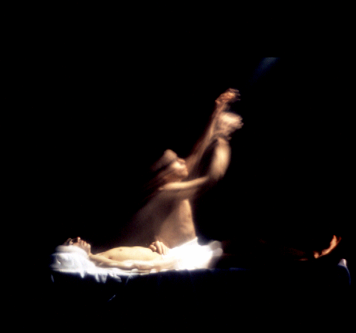
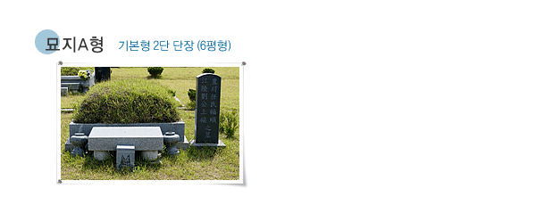

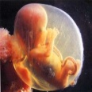
Training Universal Life : 3 Stage Life
3 Stages of Life
S.World
3rd Stage
S.Self
CIG Life in S.World
S.Self
Death
(2nd Birth)
Never Die
CIG Life on Earth
3rd B.
P.Self
2nd B.
Surely Die
1st B.
God
P.World
2nd Stage
P.Self
1. Human : S.Self & P.Self 2. P.Self : Surely Die
3. S.Self : Never Die 4. S.World : Cannot Hide
5. Life of S.Self : By P.Life 6. Breath of S.Self : True Love
7. Original Life : 3 stages 8. New Age : Cosmic Age
S.Self
P.Self
1st Birth
1st Stage

Slide 17
Mission of True Parents
● Building Substantial CIG (Unified Nation of Universal Peace)
  on earth and in heaven
● Rebirth & Resurrection of Humankind
on earth and in heaven
● Restoration of Hell on earth and in heaven
● Building Kingdom of God on earth and in heaven
● Universal course to restore substantial Canaan

Slide 18
Why Cheongpyeong Works?
Rebirth
of
Spirits
S. World
Spirits
Establishing
Foundation
for True Father
Resurrection
of
Spirits
Lineage
of
Spirits
Building
a
CIG HQ town
Restoration
of
Angels
Cleansing
of
Hereditary Sins
Witness
of
3 Stage Life
P. World
Humanity

Slide 19
Why Cheongpyeong Works?
S. World
Spirits
Establishing
Foundation
for True Father
Establishing Foundation for
True Father’s Activities in heaven
(480 billion Blessed Spirits)
(Creation of Circumstance’s in heaven)
P. World
Humanity

Slide 20
Why Cheongpyeong Works?
Rebirth
of
Spirits
S. World
Spirits
Establishing
Foundation
for True Father
Cleansing
Original Sin
of Spirits
(Restoration of
Lineage of Spirits)
(1st Blessing of Spirits)

Slide 21
Why Cheongpyeong Works?
S. World
Spirits
Rebirth
of
Spirits
Establishing
Foundation
for True Father
Resurrection
of
Spirits
Cleansing
Fallen Natures & Sins
of Spirits
(1st Blessing of Spirits)

Slide 22
Why Cheongpyeong Works?
Rebirth
of
Spirits
S. World
Spirits
Establishing
Foundation
for True Father
Resurrection
of
Spirits
Lineage
of
Spirits
Cleaning H & W relationship
of Spirits
: One Husband-One Wife
(2nd Blessing of Spirits)

Slide 23
Why Cheongpyeong Works?
Rebirth
of
Spirits
S. World
Spirits
Establishing
Foundation
for True Father
Resurrection
of
Spirits
Lineage
of
Spirits
Restoration
of
Fallen Angels
(3rd Blessing of Spirits)
Restoration
of
Angels

Slide 24
Why Cheongpyeong Works?
Rebirth
of
Spirits
S. World
Spirits
Establishing
Foundation
for True Father
Resurrection
of
Spirits
Lineage
of
Spirits
Confidence of
3 Stage Life &
Universal Life
Restoration
of
Angels
Witness
of
3 Stage Life
P. World
Humanity

Slide 25
Why Cheongpyeong Works?
Rebirth
of
Spirits
S. World
Spirits
Establishing
Foundation
for True Father
Resurrection
of
Spirits
Lineage
of
Spirits
● Cleansing Hereditary Sins
of Descendants
(Fallen Natures caused by Spirits)
● Cleansing Diseases & Problems
caused by Spirits
Restoration
of
Angels
Cleansing
of
Hereditary Sins
Witness
of
3stage Life
P. World
Humanity

Slide 26
Why Cheongpyeong Works?
Rebirth
of
Spirits
S. World
Spirits
Establishing
Foundation
for True Father
Resurrection
of
Spirits
Lineage
of
Spirits
Building an Ideal Base
centered on Peace Palace
Providential Events,
Education for Leaders
Training & Experience
of Restored Garden of Eden
Building
a
CIG HQ town
Restoration
of
Angels
Cleansing
of
Hereditary Sins
Witness
of
3stage Life
P. World
Humanity

Slide 27
Success Factors of Cheongpyeong Works
 Thoroughly Keeping Center on God & True Parents
- Absolute Faith  Love  Obedience to God & True Parents
 Success Formula #1
If we do anything centered on God & True Parent, we will succeed!!!
 Thoroughly Keeping Center on True Love & Word
- Education & Practice of Five Platforms, Ways to Heaven
 Success Formula #2
If we do anything centered on True Love & Word, we will succeed!!!
 Thorough Cooperation between S.World & P.World
Hoonmonim’s Absolute Obedience and Unity with
Heungjin Nim & Daemonim
 Success Formula #3
If we do anything in Unity with Heavenly S.World, we will succeed!!!
 Thorough Keeping Management and Leadership
Modern management Skills & Leadership, Continuous Education, Education/Practice of 3E Talents
 Success Formula #4
If we do anything with serious Analysis/Preparation, we will succeed!!!

